Slide 1
AGEPOR Congress May 2014
NEW OPPORTUNITIES FOR THE SHIP AGENCY BUSINESS – THE EXPECTATIONS ABOUT THE SHIPPING INDUSTRY AND MY THOUGHTS ABOUT THE FUTURE
“Support your future”
Tonny Dalhøj Paulsen

Slide 2
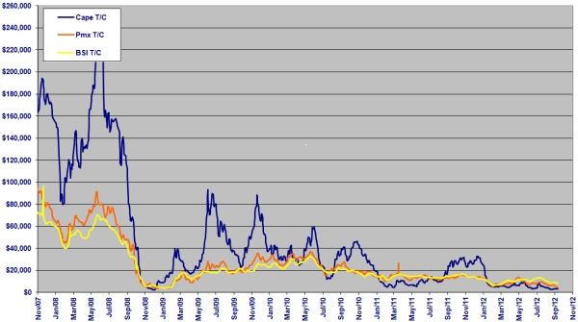
Average T/C rates US$/Day

Slide 3
Average daily earnings for single voyage for VLCC and Product Tankers
 | 2008 | 2012
VLCC | US$ 89.000 | US$ 21.000
Product Tankers* | US$ 44.000 | US$ 12.000
*Product Tankers / LR2 85.000 – 110.000 DWT

Slide 4
Seaborne liftings according to UNCTAD ”Review of Maritime Transport 2011”
2010 | 8,9 Billion Metric Tons
2000 | 5,9 Billion Metric Tons
Tonmiles not comparable

Slide 5
Global Seaborne Trade made up in million tons
 | 2000 | 2009 | 2012
Oil | 2,179 | 2,605 | 2,743
Bulk | 1,281 | 2,068 | 2,612
Other commodities | 2,453 | 3,288 | 4,144
Containers (1,000 TEU) | 67,600 | 131,400 | 169,800

Slide 6
Therefore, the question seems very appropriate:
Why do we talk about a shipping crises with increasing volumes …………
There might be many answers but one is for sure……
Too many vessels and even larger vessels than before.
“No return to the glorious days and sky high rates”

Slide 7
Forecast 2030
Global cargo volume around 19-34 Billion tons.
China major importer and exporter:
Tripling of oil comsumption.
Consumption of 60% of global coal production.
Market leader in non-food consumer goods
Chinese ship owers and ship operators expected to be number One in the world.

Slide 9
Abbreviation
BWMC | Ballast Water Management Convention
ECA | Emission Control Areas
EEDI | The Adoption of the Energy Efficiency Design Index
LNG | Liquefied Natural Gas
MBM | Market Based Measures
MLC | Maritime Labour Convention
NO_{x} | Nitrogen Oxides
SEEMP | The Ship Energy Efficiency Management Plan
SO_{x} | Sulphur Oxide

Slide 10
New standards!
Environmental issues and challenges will have effect also on Agency and Shipbroking business.
Requirements for even higher professional education will increase to match the level of our stakeholders.

Slide 11
Examples of new activities
Back Office Services for major container operators, Break Bulk operators
Project shipments (site to site)
Off Shore services (Pilots, tugs, deliveries, water etc.)
Ship-to Ship transfer (STS operations)
Partnership with customers
Warehouising incl. end-user deliveries
Operation of T/C-tonnage
Own LCL services
NVOCC services

Slide 12
Off-Shore Activities
Oil and gas were the frontrunners and gave first experience.
Windturbines and windfarms in the North Sea are now hot topic and expected to increase 10 times over the next 8-10 years.
Maintenance services and later recycling of platforms and installations.

Slide 13
The Arctic Region
Danish companies are pioneers and have high level of expertice from trading on Greenland.
Danish Authorities are heavily involved in regulations, security and various recommendations.
The Cruise industry see new opportunities in such trade.

Slide 14
Cooperation with authorities
Danish shipping is considered estremely important to Denmark and the Danish Authories and Government are keen on listening to the industry.
Before proposals for new rules and regulations are ratified the Blue Denmark and the various association are invited to comment and to voice their opinion.

Slide 15
The visions for the growth plan are as follows
• Denmark should be the maritime centre of Europe
• Green solutions are the future for the Blue Denmark
• Growth in the maritime cluster should be supported by strong Danish competences

Slide 16
This should be achieved by:
1. The Blue Denmark should be marketed as the core of maritime Europe.
2. It should be attractive to do maritime business in Denmark.
3. Growth should be created through green shipping and green solutions.
4. The Danish maritime strengths should be developed and utilised to create growth.
5. Maritime competences, training and education programmes, research and innovation should support growth.
6. Growth should be based on quality shipping.

Slide 17
Notes:
Jeg har lige redegjort for, at vi tjener pengene langt fra DKs strande, dette kort viser, at danske rederier har faste ruter over hele verden – det dækker liniefarten, men vore bulkrederier kommer på samme måde til lande i alle verdensdele, hvilket omsætningstallene jo viste godt.
De globale søfartsmarkeder er heldigvis stort set alle liberaliserede således at vi kan betjene alle markeder.
Det samme gælder for vores konkurrenter. I danske farvande sejler skibe fra alle verdensdele. Vi har ikke noget hjemmemarked for os selv – det er samme konkurrencesituation vi møder her i Europa som i Asien eller USA.
Vi har således i mange år måttet håndtere udfordringerne fra globaliseringen, og som jeg tidligere har vist, så har danske rederier forstået at udnytte de muligheder, der ligger i at hele verden bliver vores hjemmemarked. Vi er afhængige af at operere og tænke globalt.

Slide 18
More than 90% of the world trade is carried by ships and shipping is the lifeblood for global development.
Without agents, brokers and the like to support and serve shipping there will be no international transport of goods.
The future is very bright – but we all need to face the challenges with an open mindset.

Slide 19
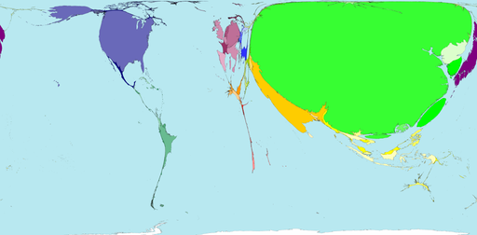
Thank you very much
How the World would look if based on cargo volumes

